Slide 2
Vision
Our vision is to sustain a vibrant urban and community agriculture movement in Hamilton County.
Mission
…by supporting the knowledge and inspiration of its leaders. The network will encourage the sharing of local knowledge, encourage collaboration, and offer training, education, and equipping.

Slide 3
We’re all in this together…
Similar challenges and limited resources
Strength and resiliency TOGETHER
New garden(ers) can learn from the successes and bumps in the road experienced by others
Space to support, encourage, learn, commiserate, and GROW
Develop new ways to address challenges

Slide 4
Joke Time!
What do you get if you divide the circumference of a pumpkin by its diameter?

Slide 5
pumpkin pi.

Slide 6
Weeds: A Relational Perspective
Moving from Phytocentric to an Ecocentric Perspective

Slide 8
Fear of Weeds!!!!

Slide 9
Notes:
The number one rule in being a bad guy is to never shoot the messenger before you get the message.
The common instinct we bring with us to the garden is the one to rid the garden of its weeds. Perhaps we are afraid of them choking out our vegetables or robbing the soil of nutrients.
But we aren’t just fighting weeds. We are fighting a law of life. In gardening and agriculture, we are actually disrupting normal ecological functions which can diminish soil quality over time.

Slide 10
Then…what is a weed?
”A plant whose virtues have not yet been discovered.”

Slide 11
Why Weeds? The Problem is the Solution
“Nature abhors a vacuum.”
With cultivation, we are disrupting normal ecological functions and creating a deficit or a vacuum
Where there is disruption, nature responds with weeds to restore ecology (relationships/symbiosis) and health within the soil
It works like this…(Andrew, this is your note to read the quote)

Slide 12
What Indicator Weeds Share w/ Us
pH (alkaline or acidic)
Fertility (high or low)
Hardpan
Compacted
Heavy Clay
Poor drainage
Moist soil

Slide 13
Rules for Reading Indicator Weeds
Look for plant communities and patterns over time
Most weeds have narrow and wide tolerances for certain environmental characteristics
Know your weeds – identify them and get to know them personally

Slide 14
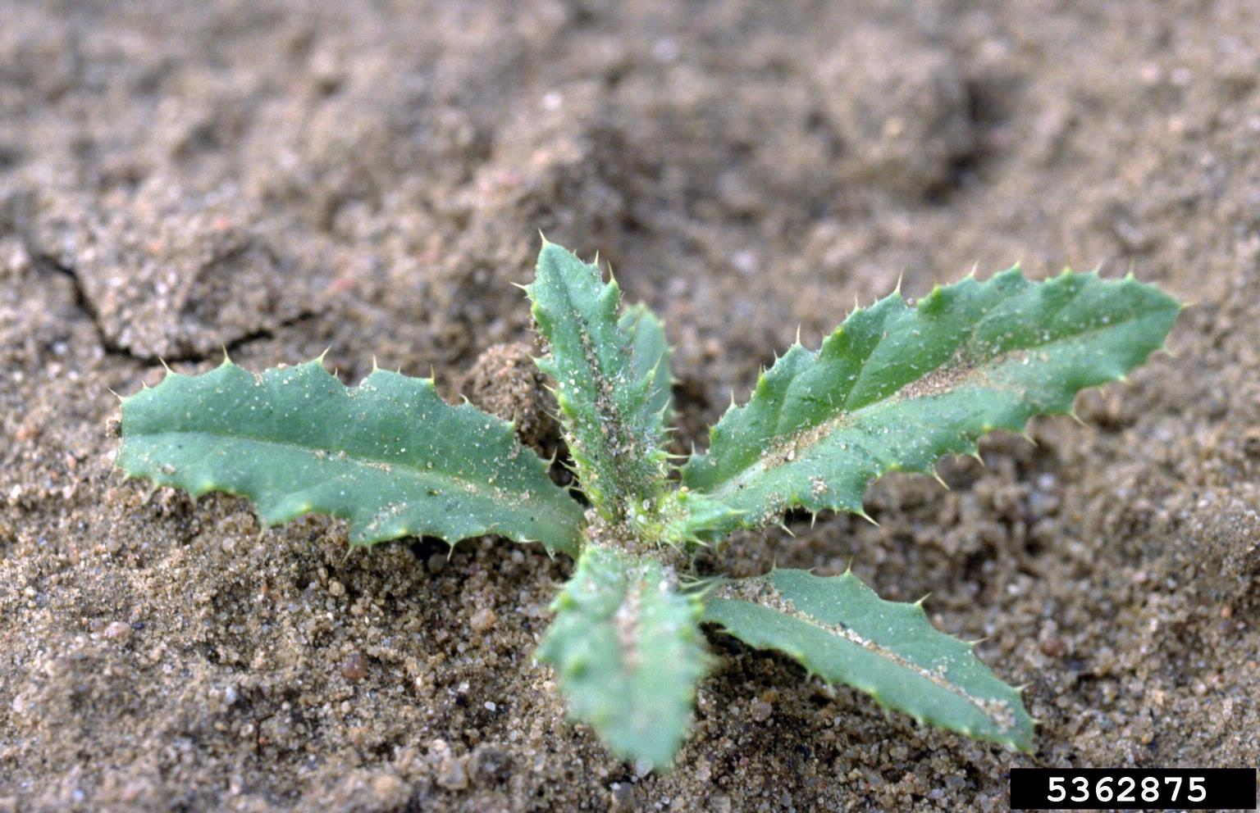
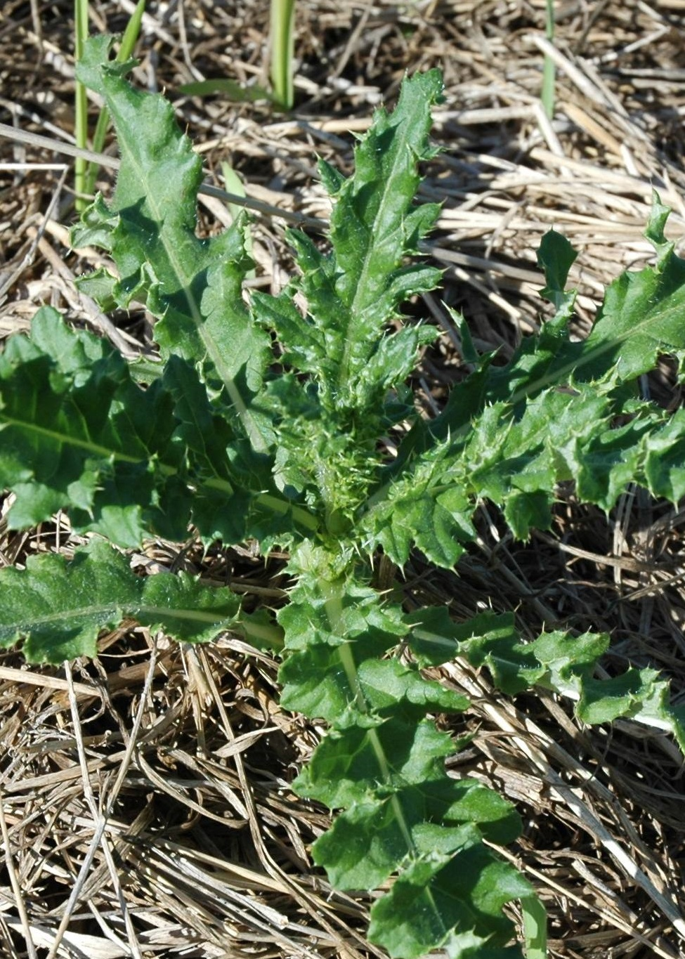
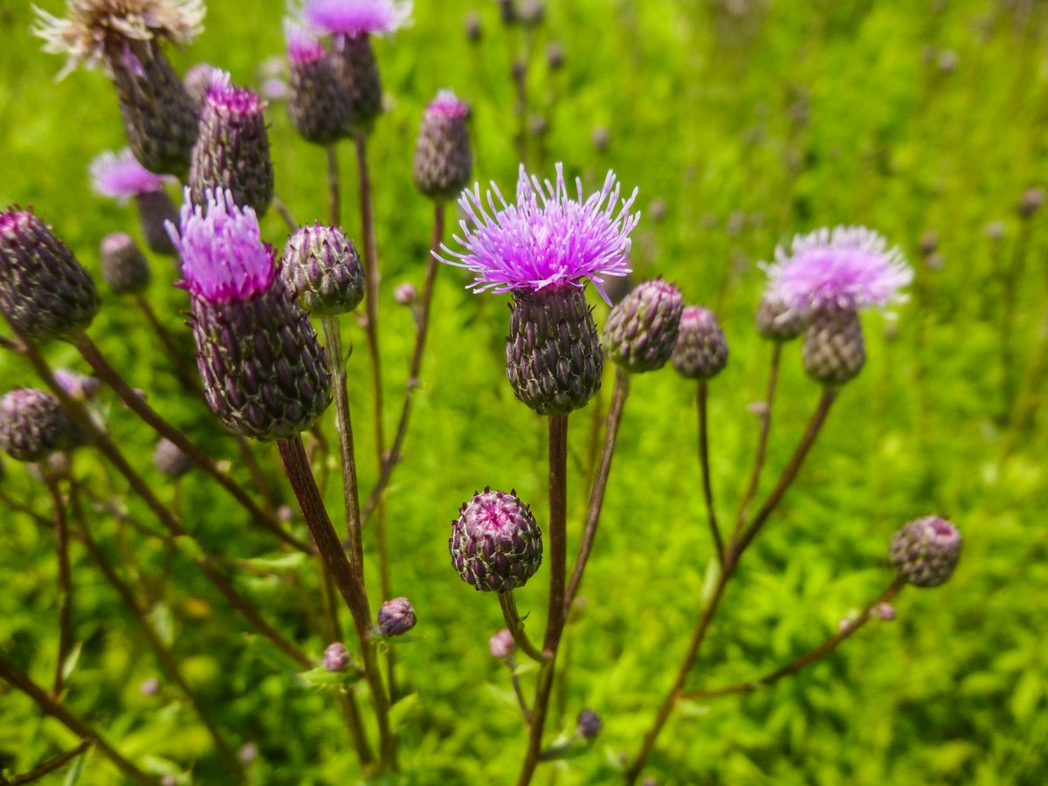
Example: Canada Thistle
Likes heavy clay soil (Hamilton County)
Breaks up compaction
Roots can go as deep as 20’ – accumulating minerals and nutrients and deposited as carbon and organic matter
Increases porosity of soil
The vacuum? Loss of tree’s, soil compaction, loss of organic matter. They fill the void.

Slide 15
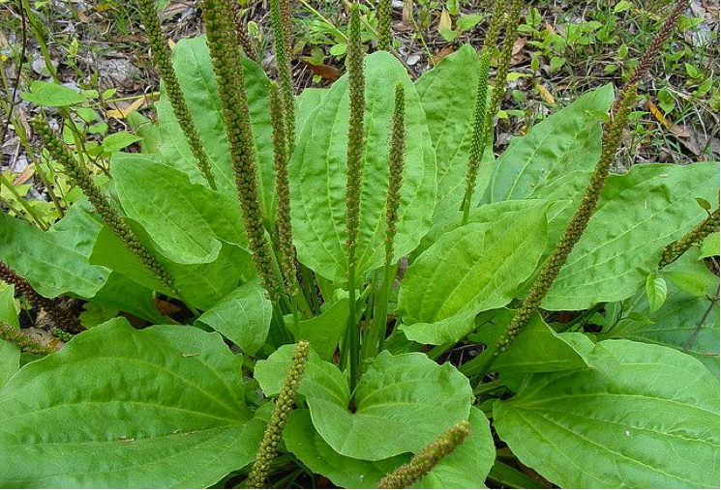
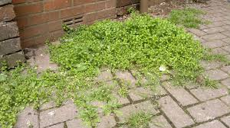
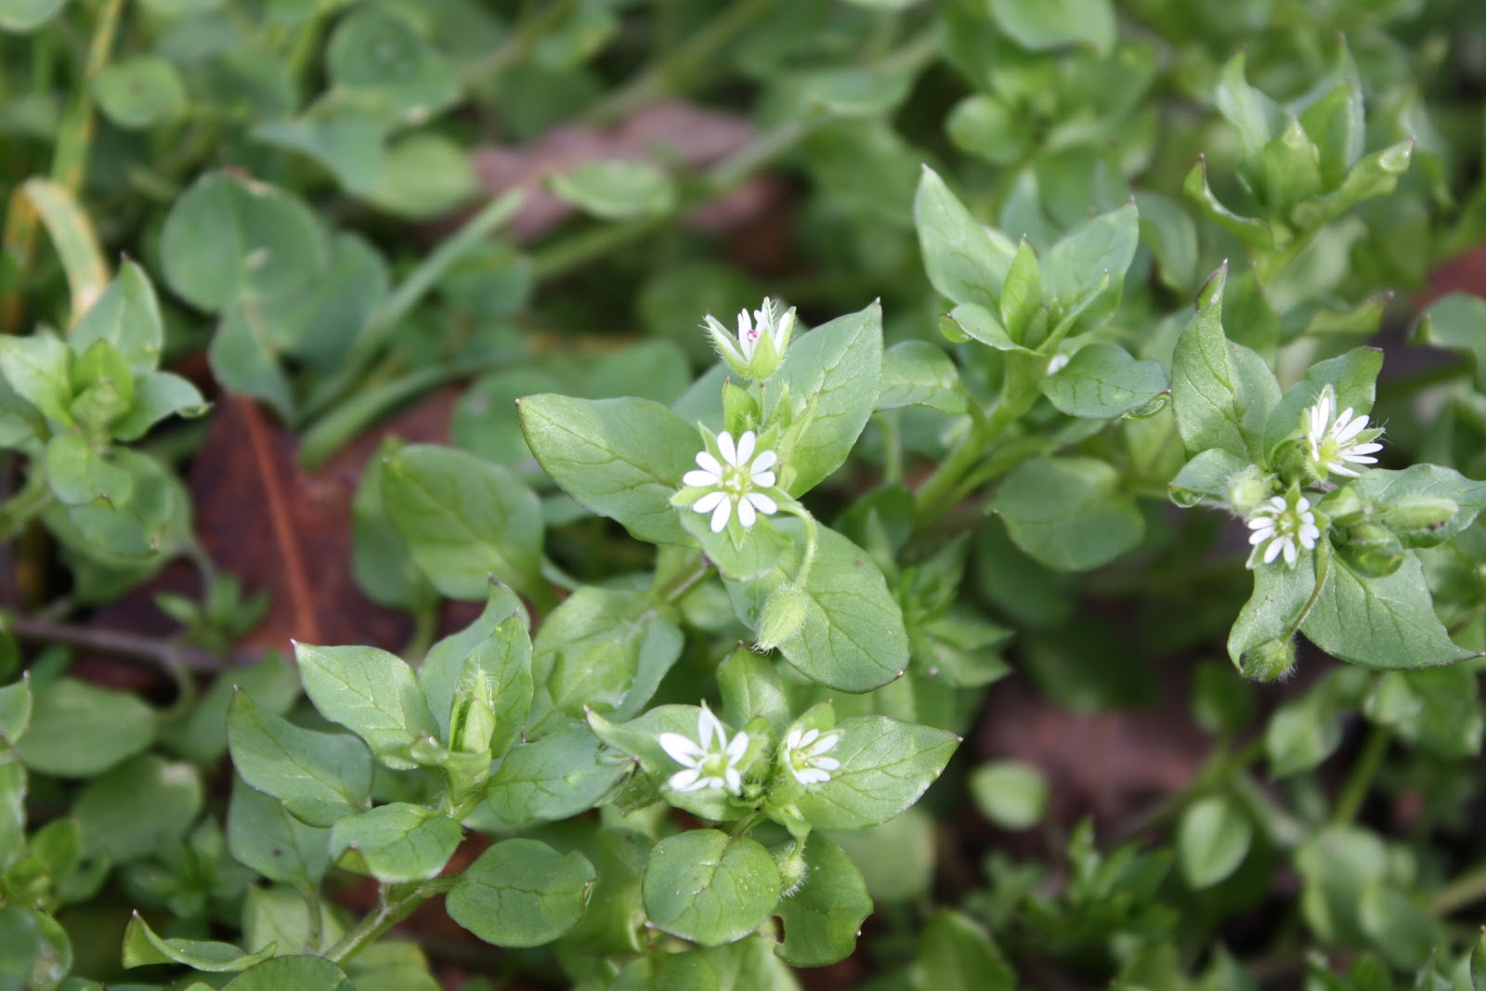
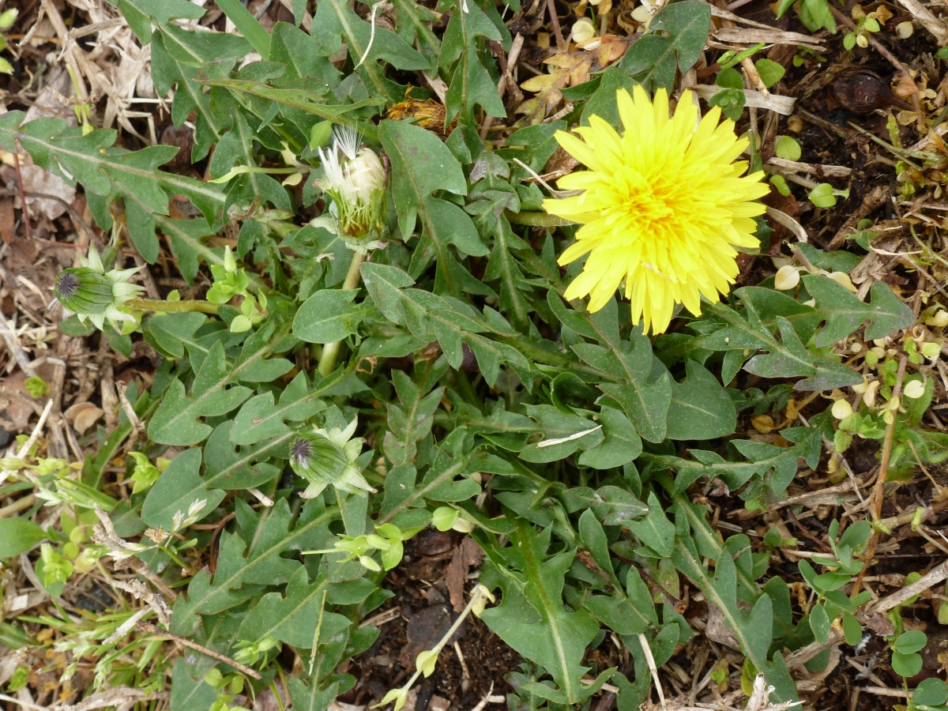
Indicator Weeds for Compacted or Heavy Clay Soil
Broadleaf Plantain
Common Chickweed
Dandelion

Slide 16
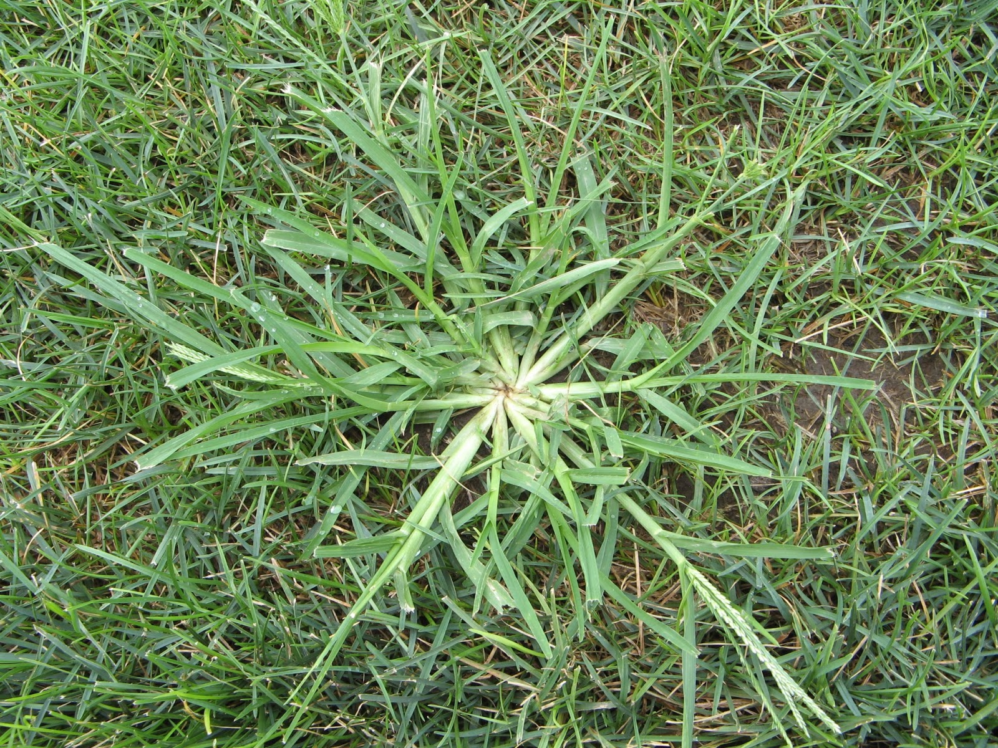
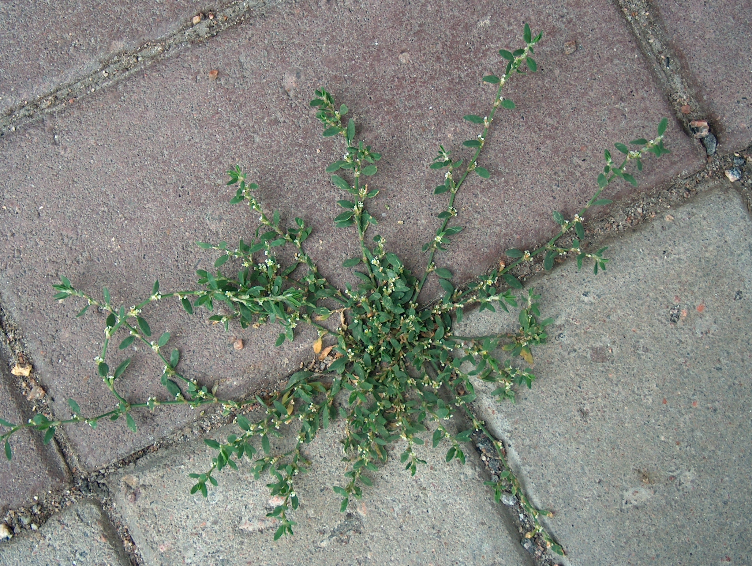
Indicator Weeds for Compacted or Heavy Clay Soil
Prostrate knotweed
Indian Goosegrass (wiregrass)

Slide 17
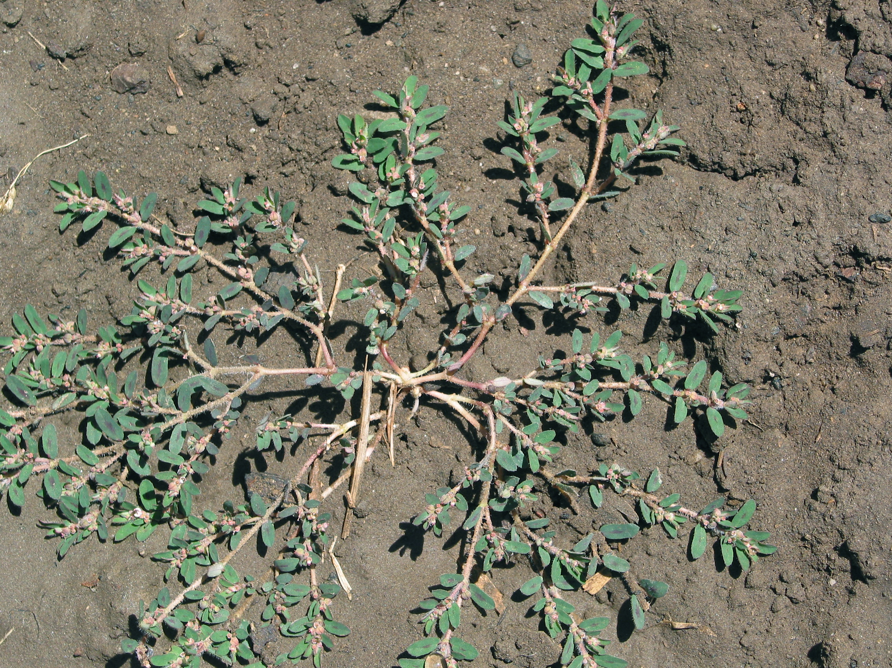
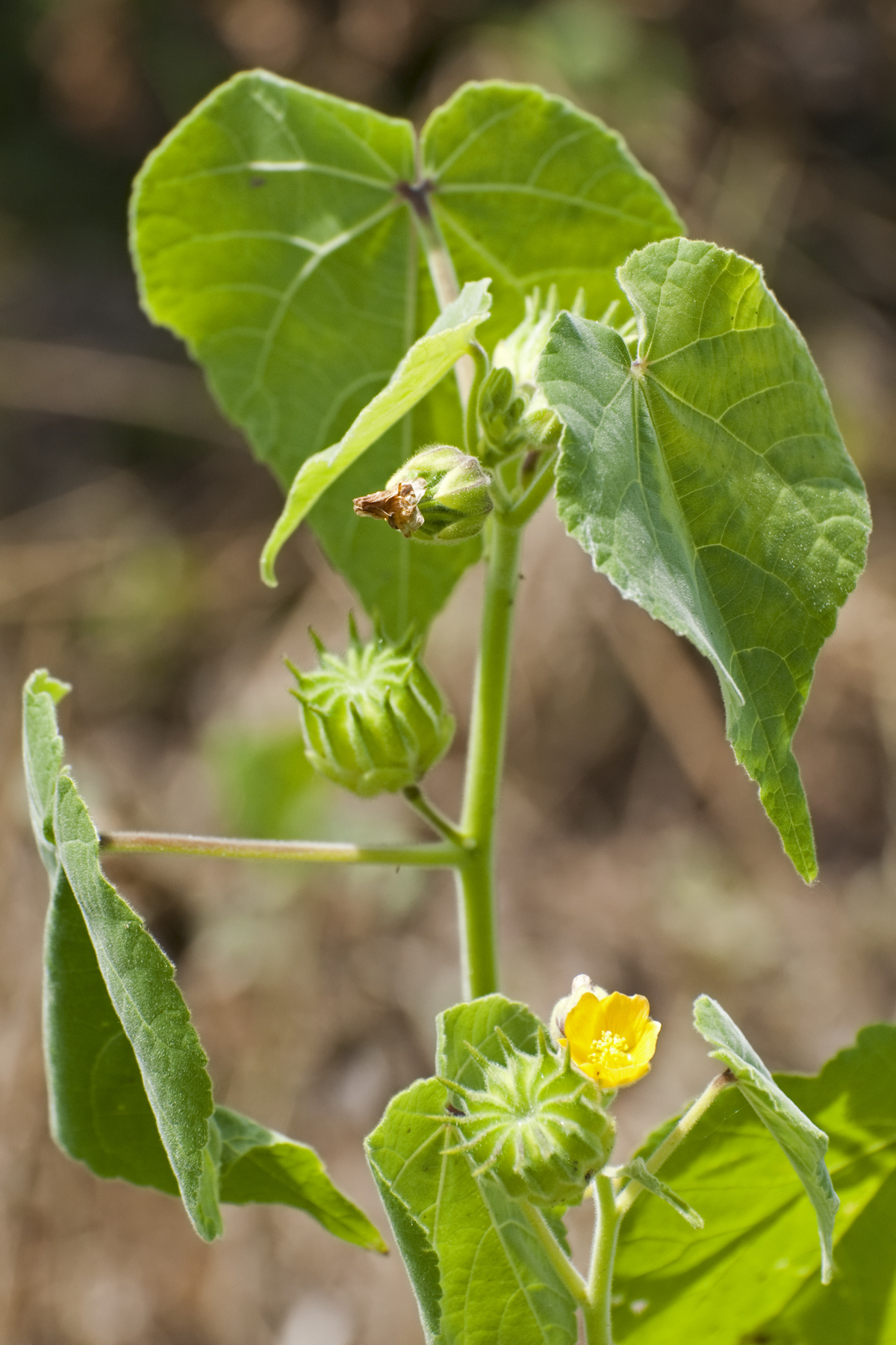
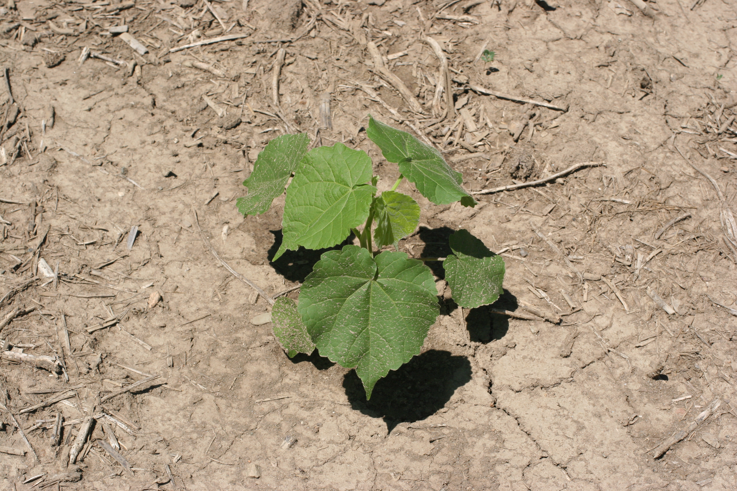
Indicator Weeds for Compacted or Heavy Clay Soil
Prostrate Spurge
Velvetleaf

Slide 18
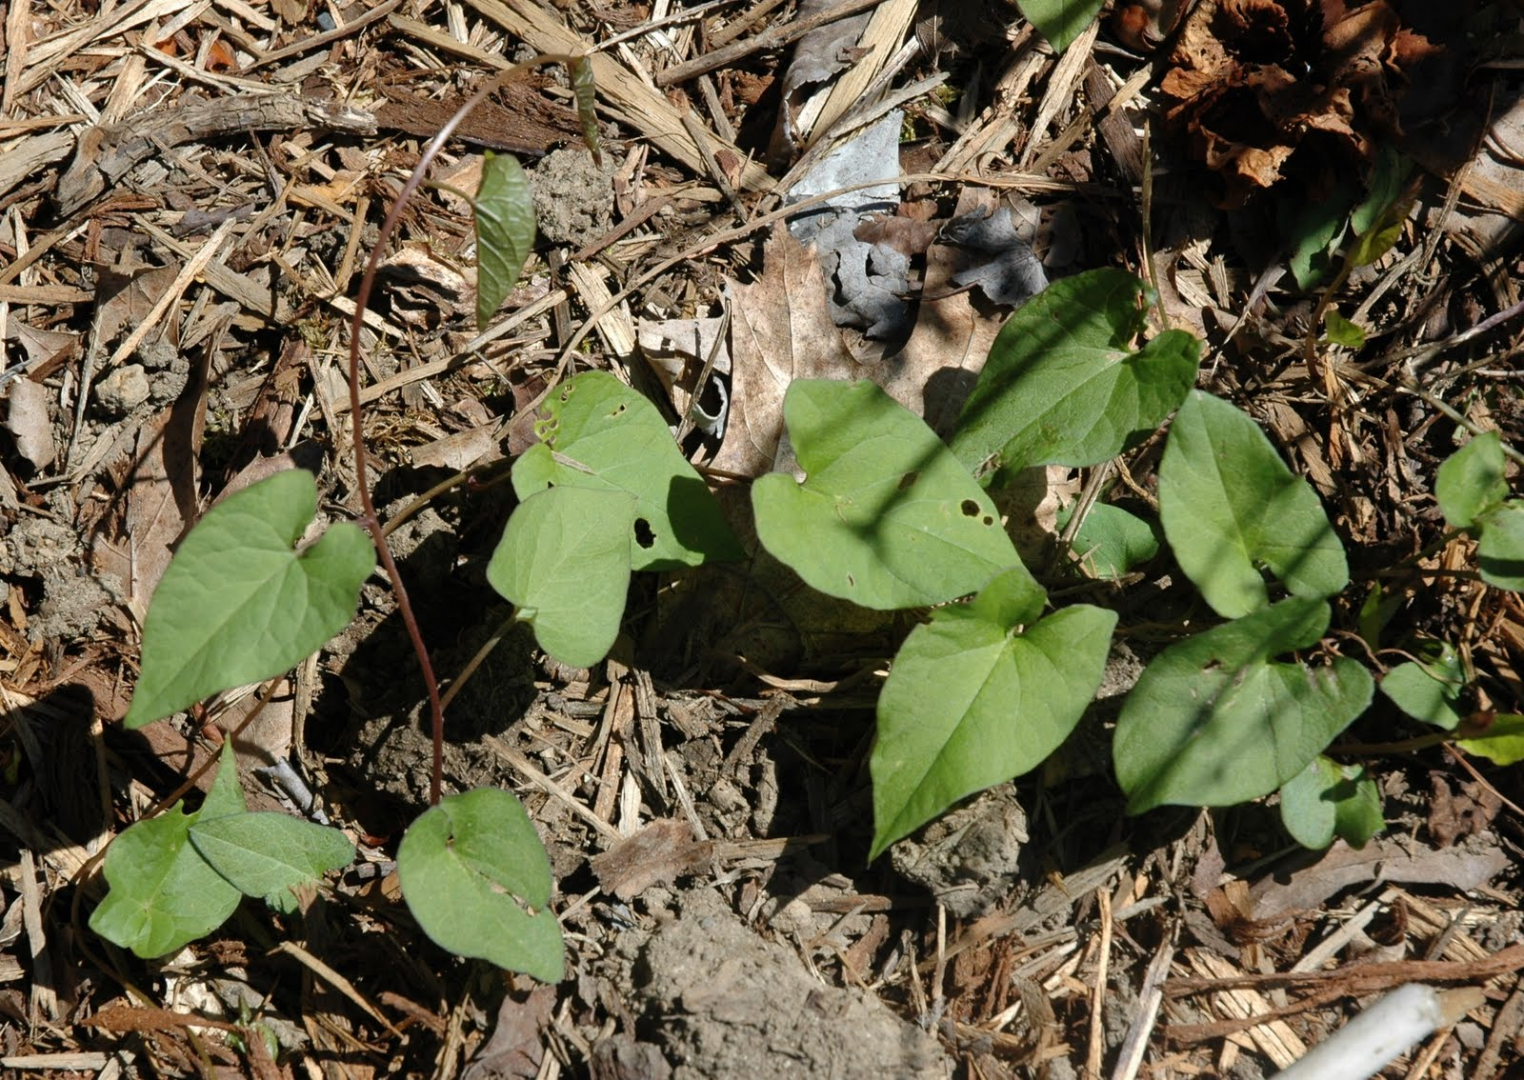
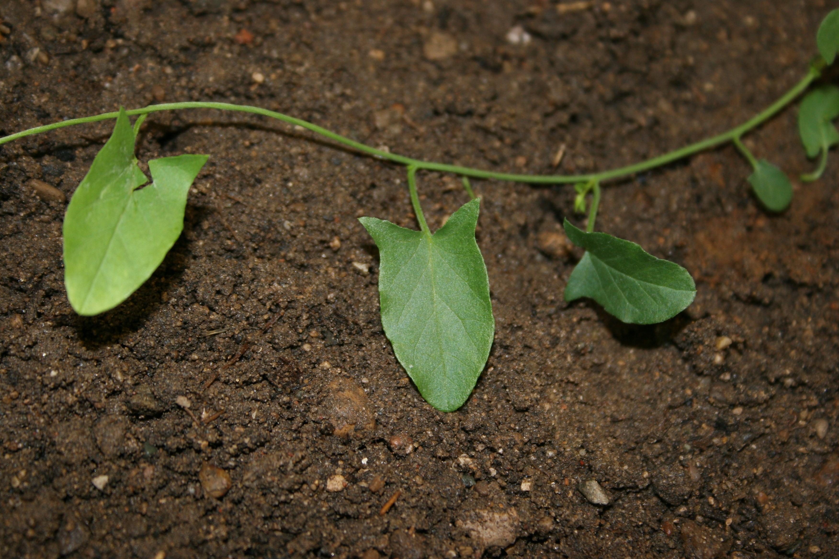
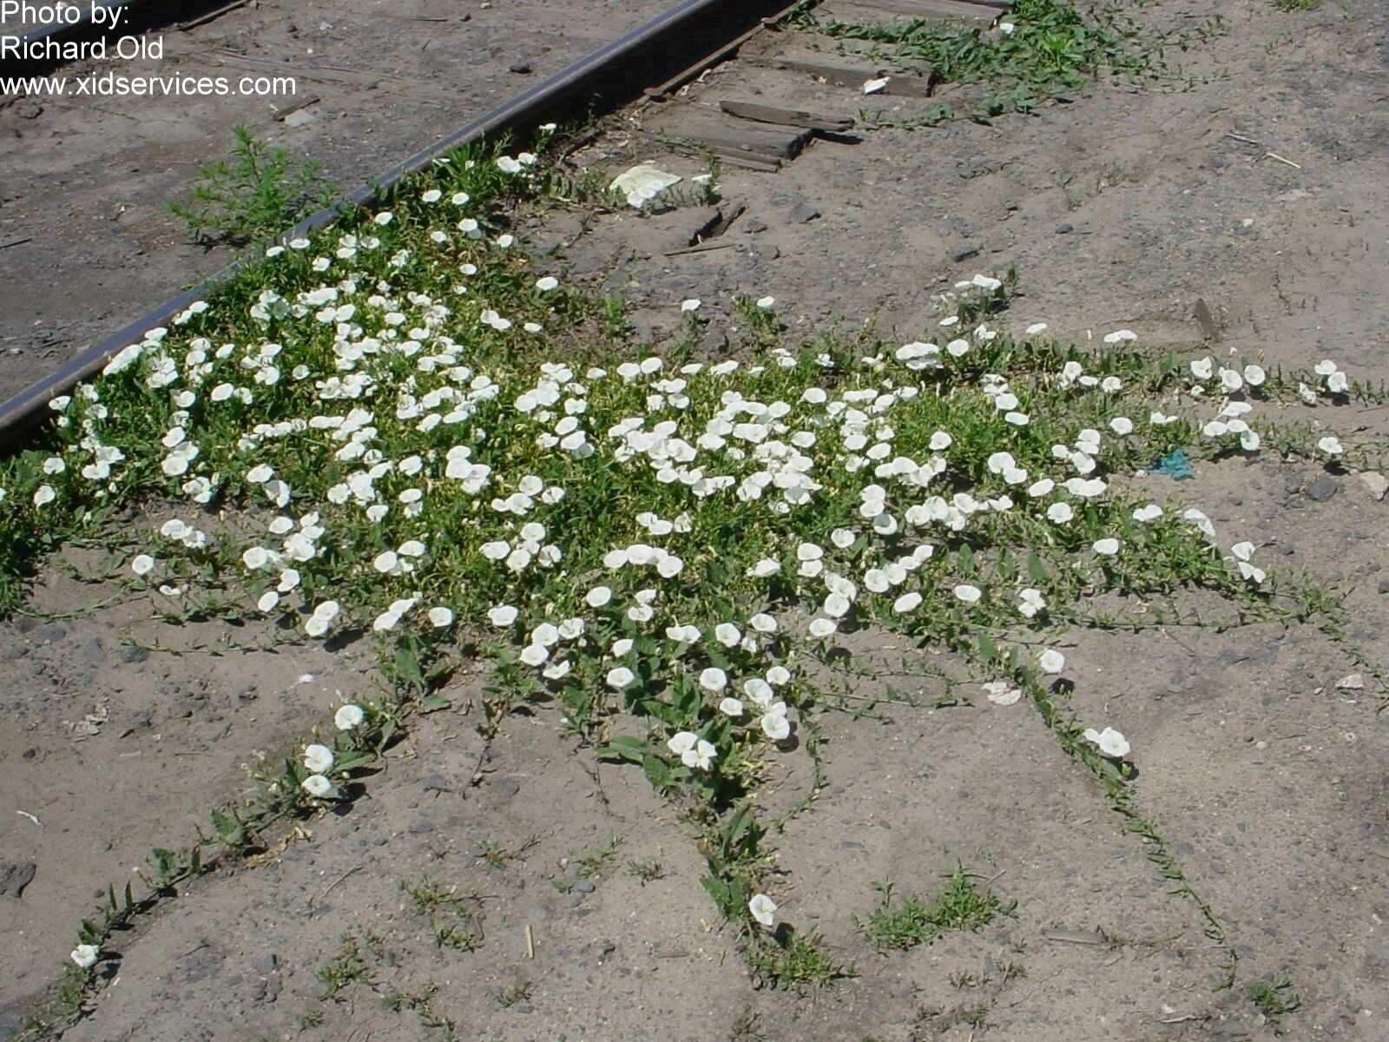
Indicator Weeds for Hardpan
Bindweed (field)

Slide 19
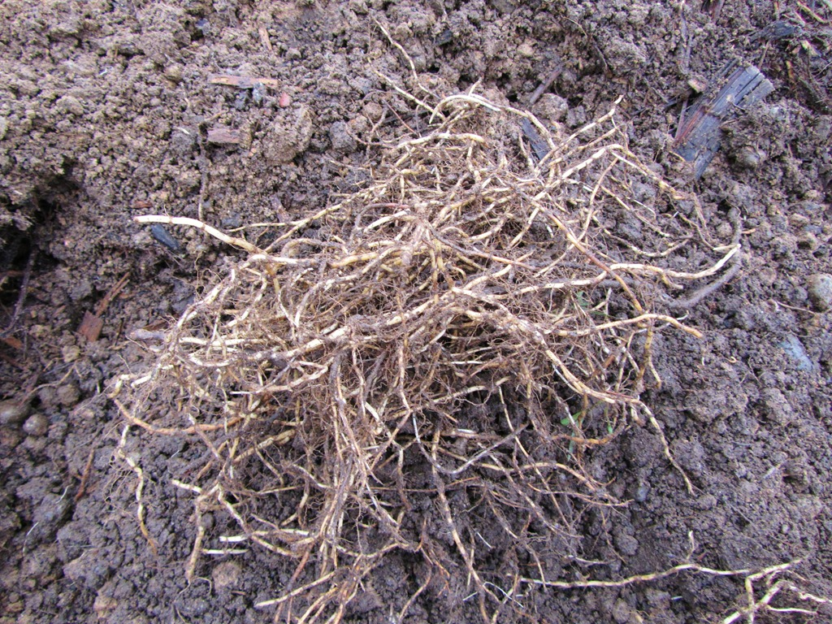
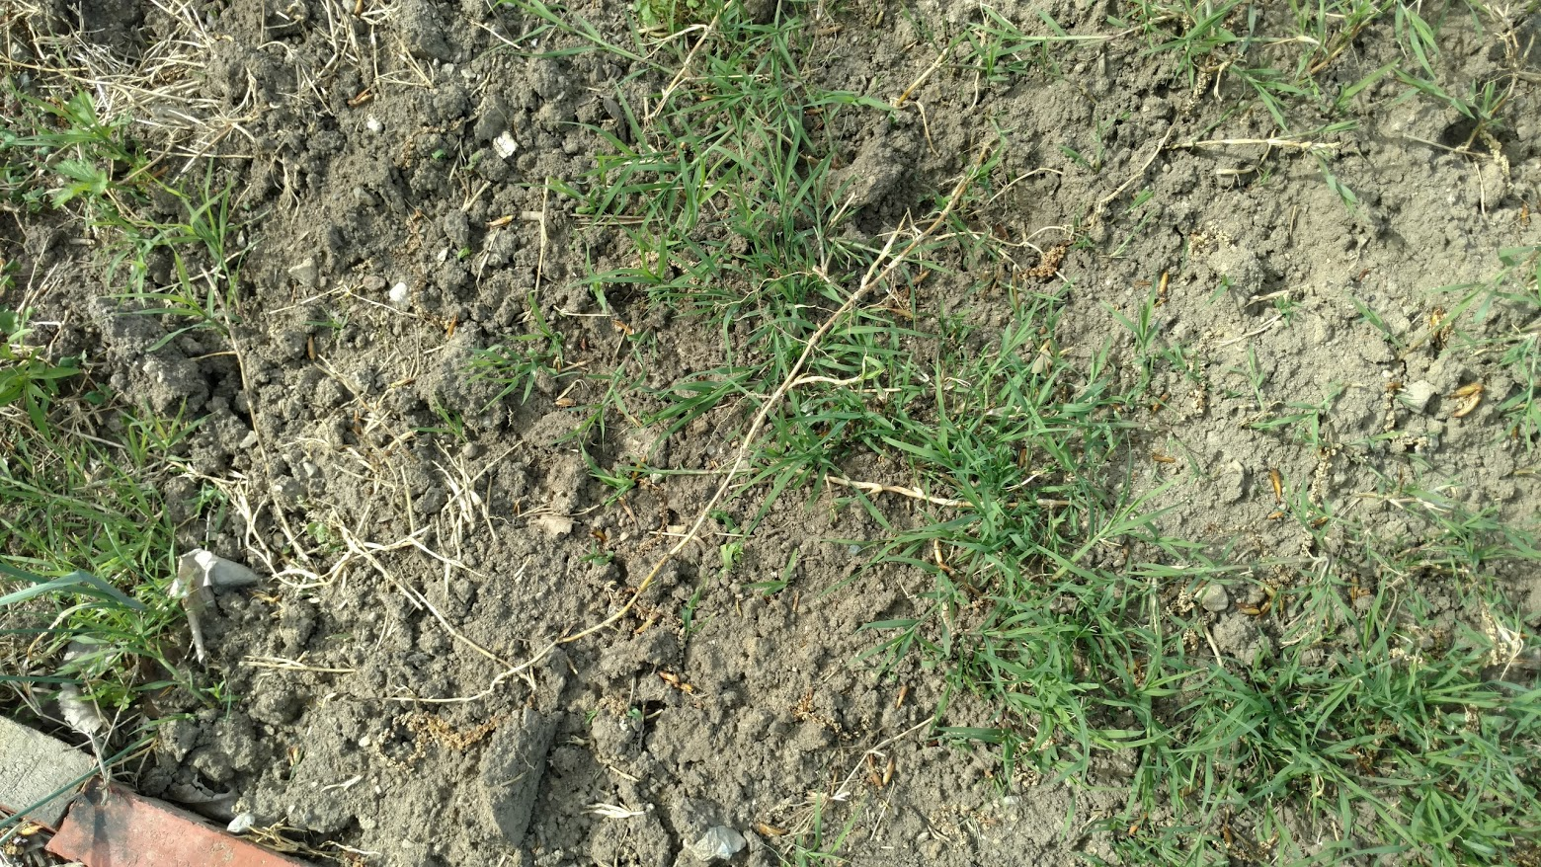
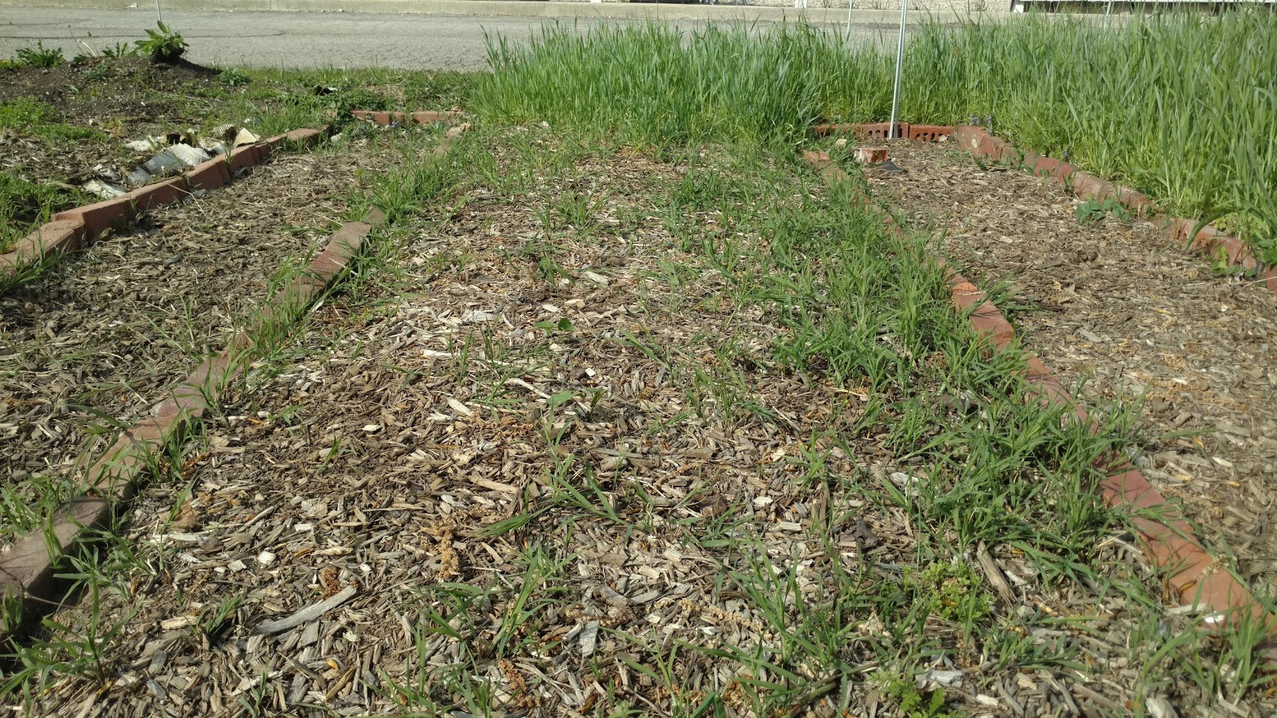
Indicator Weeds for Hardpan
Quackgrass

Slide 20
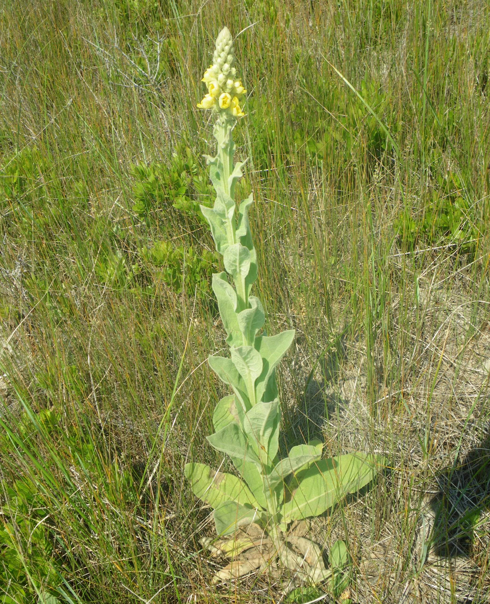
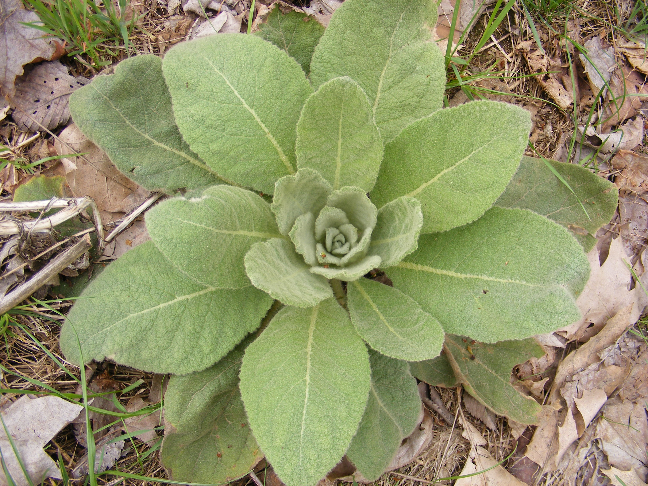
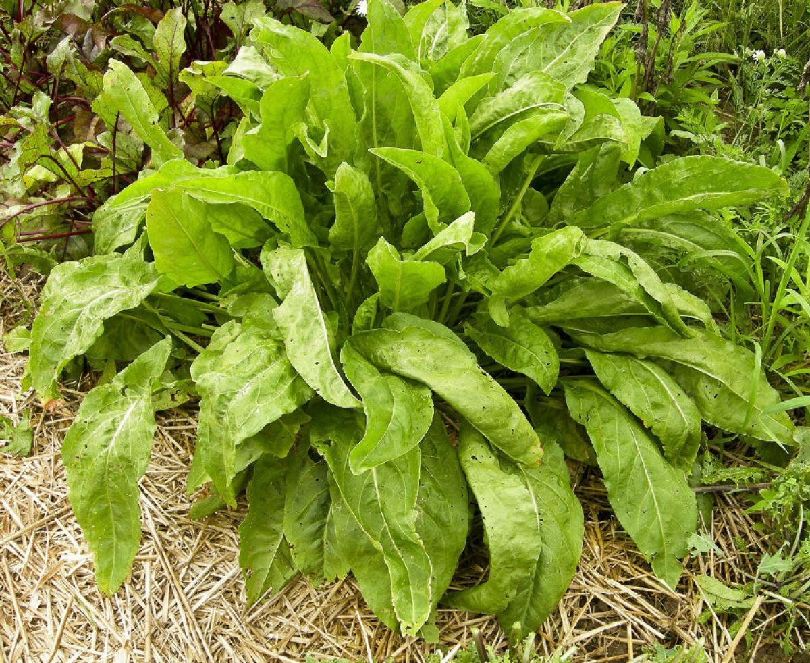
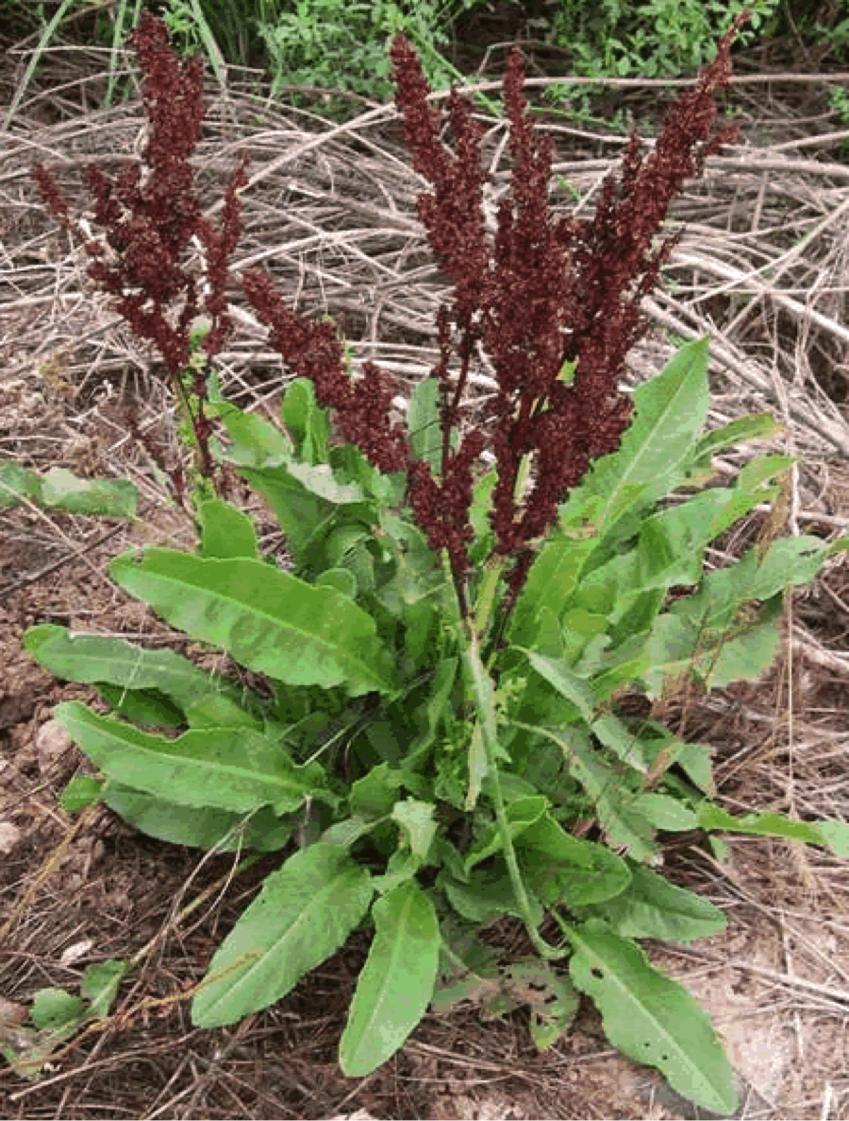
Indicator Weeds for Acidic Soil
Broadleaf Plantain
Common Mullein
Dandelion
Garden Sorrel

Slide 21
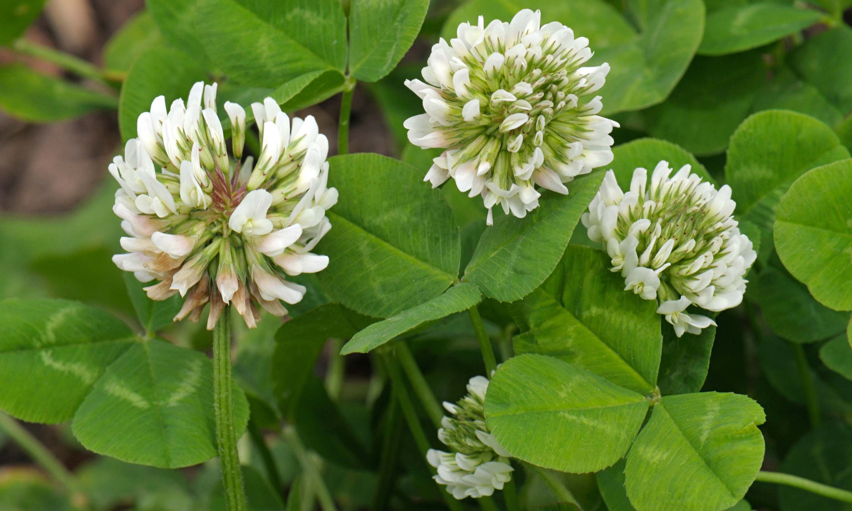
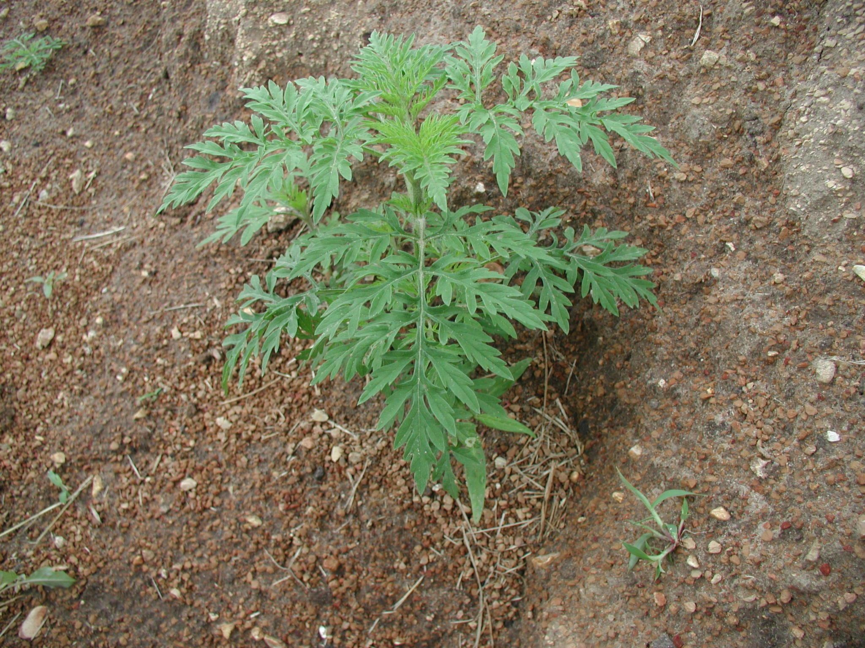
Indicator Weeds for Low Fertility
White Clover
Biennial wormwood (ragweed)
Indicator weeds for low fertility are generally accumulators of minerals or nitrogen fixers
Clover, plant legumes, radish, etc.
Others include wild carrot, common mullein, broadleaf plantain

Slide 22
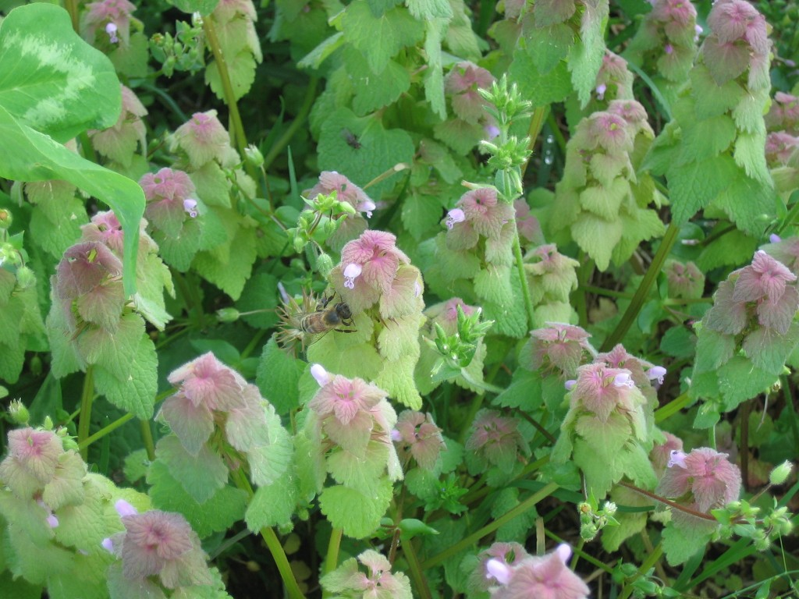
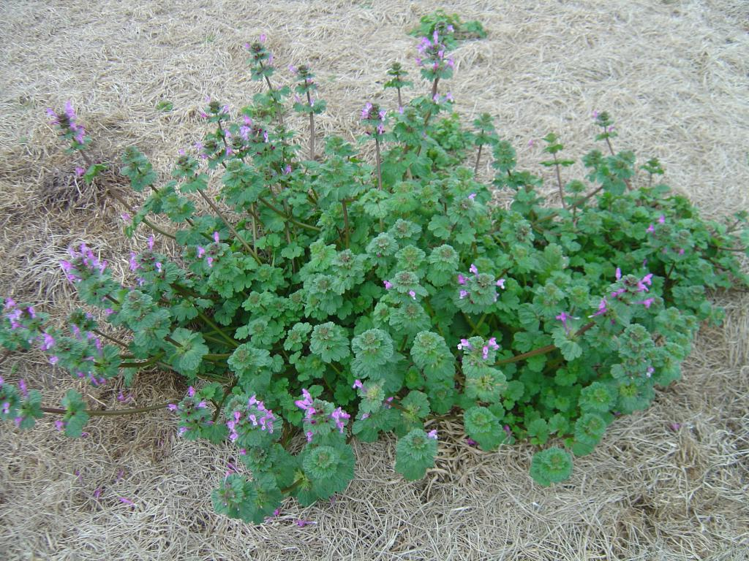
Indicator Weeds for High or Improving Fertility
Henbit dead-nettle

Slide 23
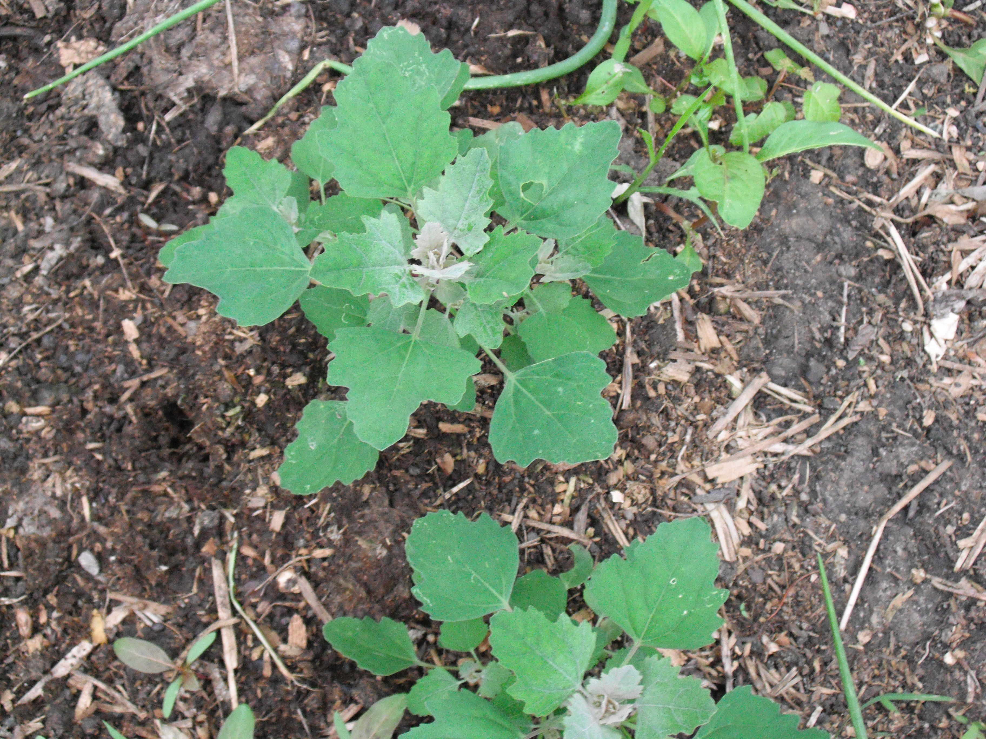
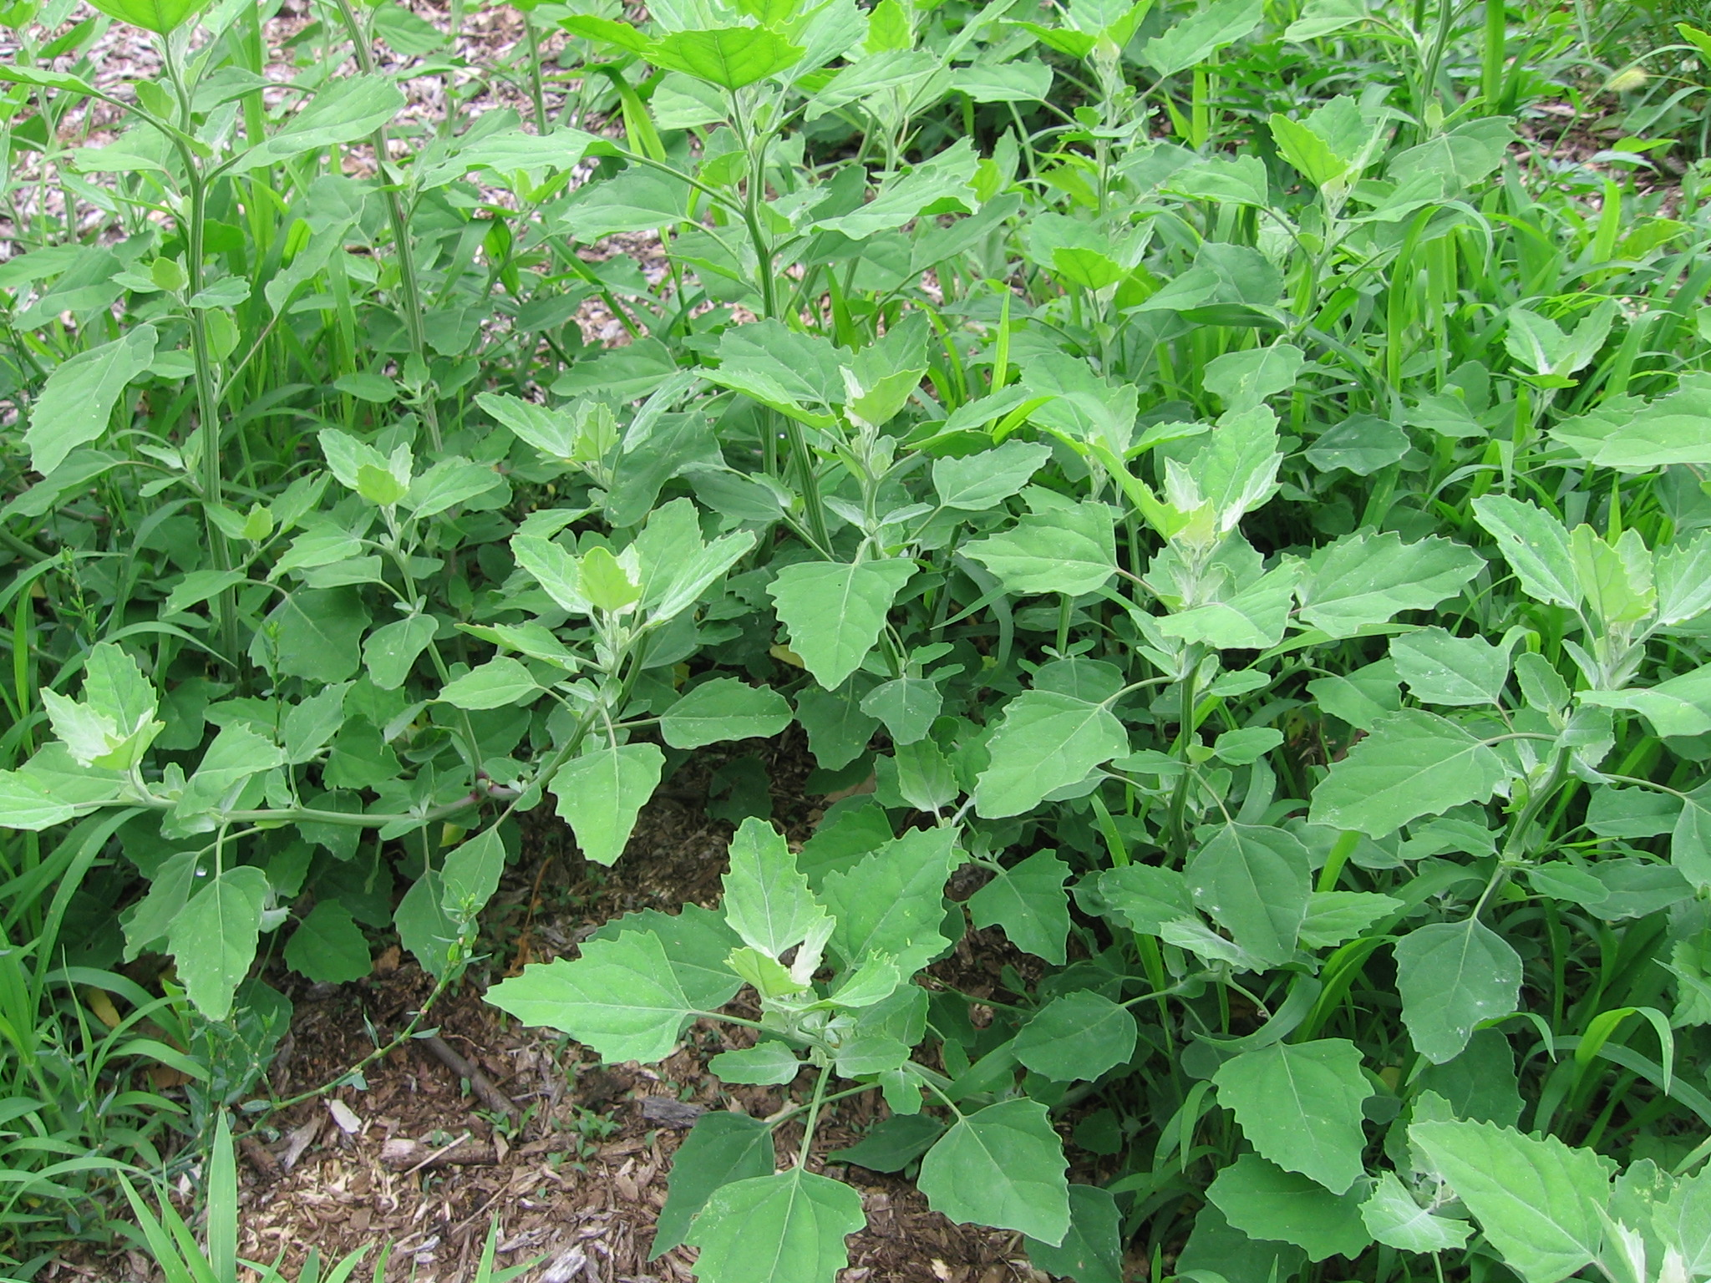
Indicator Weeds for High or Improving Fertility
Lamb’s Quarters

Slide 24
Moving from Phytocentric to Ecocentric
It’s not about the plants – it’s about the soil
If we fail to respond– we fail the soil and, therefore, the plant.
Which is why we need to move from “phytocentric” perspective to “ecocentric”
Weeds can act as a green manure or cover crop
Weeds can serve to cycle nutrients from the subsoil
Deep-rooted weeds can break up hard pans, thereby regulating water movement in the soil
Weeds can conserve soil moisture
Weeds can provide habitat for beneficial organisms
Many weeds are edible!
Fighting them often leaves a vacuum and diminishes soil health over time without understanding first what they are indicating
Be an observant farmer
Notice how weeds respond to your gardening practices

Slide 25
Weeds: Management Strategies

Slide 26
How Weeds Survive and Don’t Survive
Proliferous seeds
Seeds have high germination rates
Seeds are viable for many years
Store nutrients in roots to survive stressful events
Spread through rhizomes

Slide 27
Three Basic Methods
Mulching and Smothering
Organic Mulches
Inorganic Mulches
Shading
Cover Crops
Solarization
Mechanical
Pulling
Hoeing
Tilling
Flaming
Chemical
Allelopathy
Herbicides
Vinegar Herbicides

Slide 28
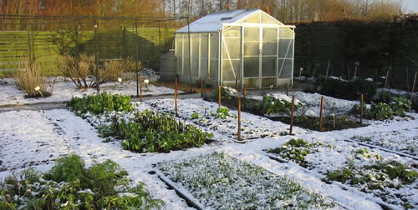
Good Rule to Follow: Winterizing the Garden
Eliminating weeds or having a weed management plan for winter goes a long way toward managing weeds in the spring
Planting cover crops or applying organic mulches to suppress weeds after removal is ideal

Slide 29
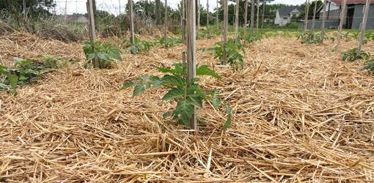
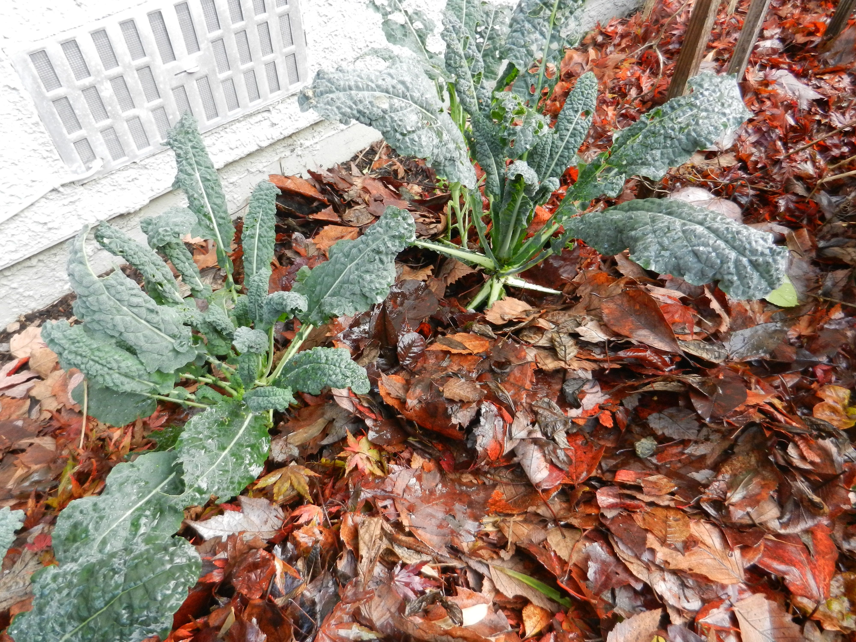
Organic Mulches
Benefits
Adds organic matter
Water and penetrate the surface
Must balance carbon/nitrogen ratio for health of plant:
Mulched Leaves or Leaf Compost
Cover Crop Residue
Rye
Oats
Clover/Vetch
Straw (assuming little to no seed)
Grass Clippings (assuming no grass seed and chemical free)
Wood Chips and Bark

Slide 30
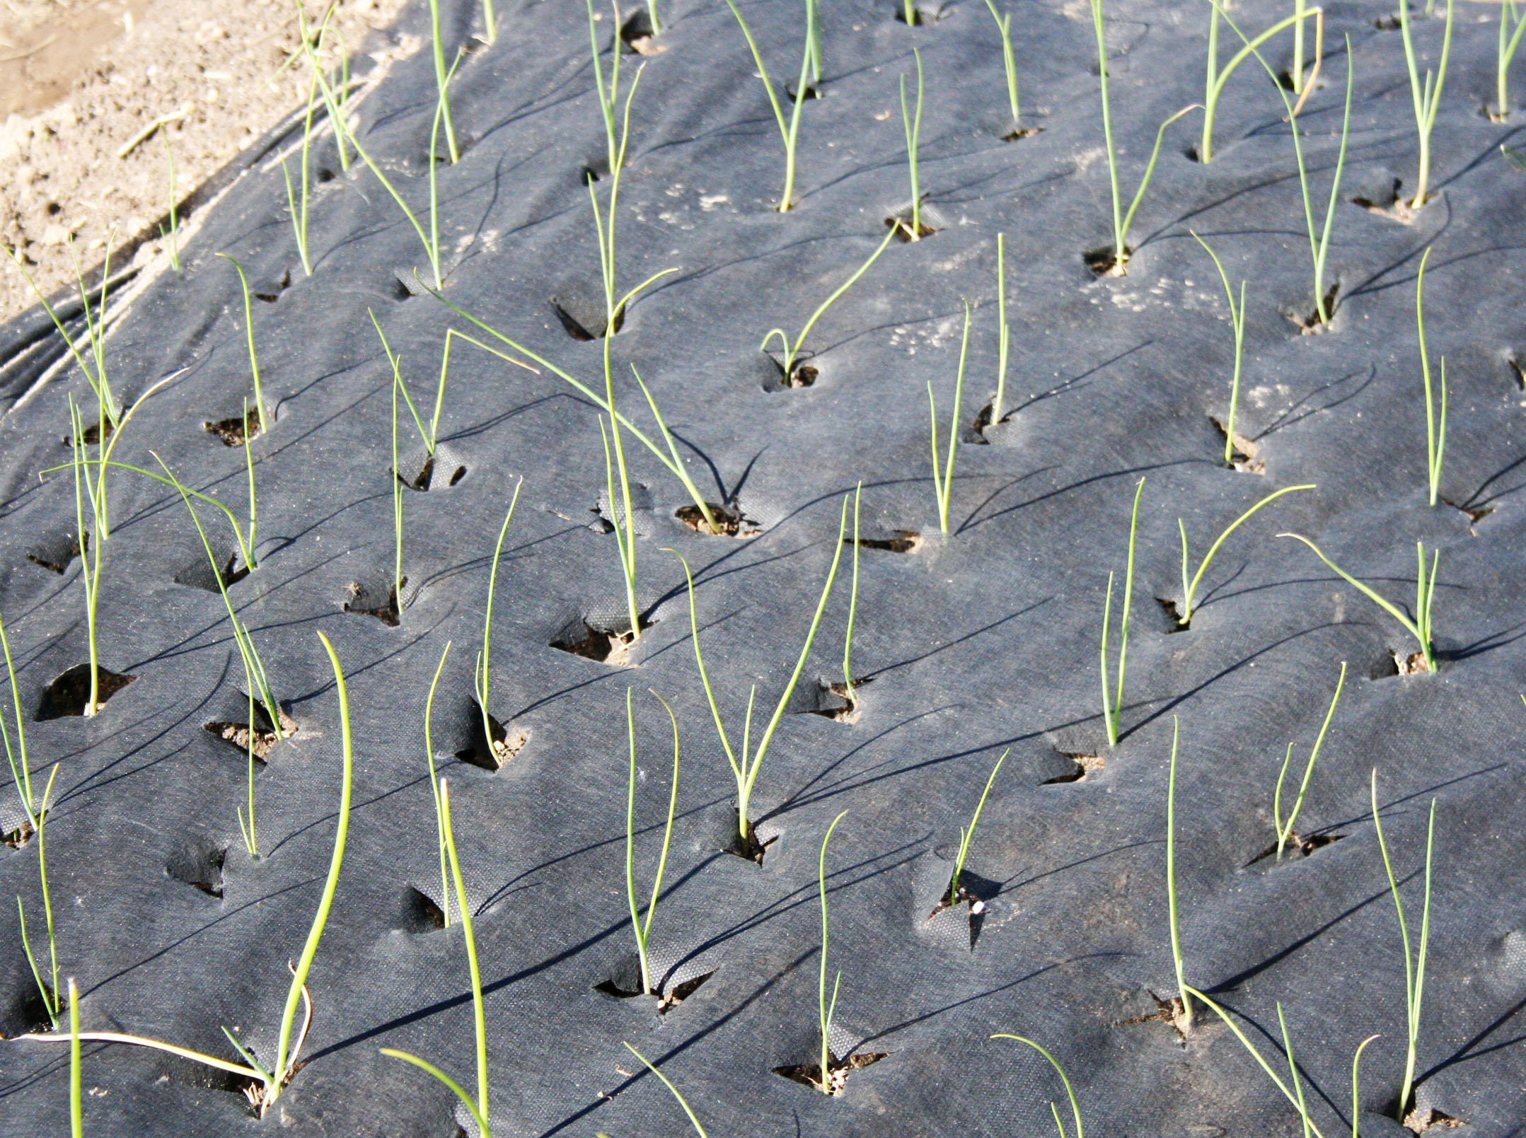
Inorganic Mulches
Benefits
Some can allow water/air to penetrate
Impenetrable
Effective
Disadvantages
Can get messy
Not adaptable to different planting plans
Can be expensive for special fabrics
Needs to be completely opaque
Must block all sunlight to be effective
If using black plastic, be mindful of soil temperatures

Slide 31
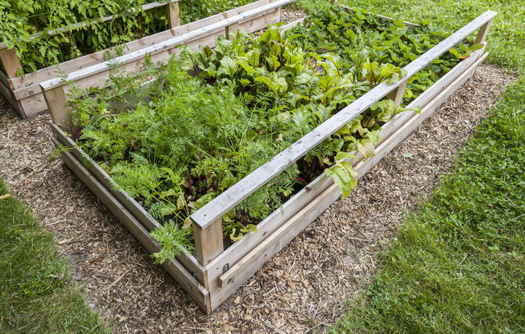
Shading
Planting densely to prevent sunlight from reaching the surface
Requires good soil health to support increased yield
Good for raised beds or highly organic soil
Must block all sunlight to be effective

Slide 32
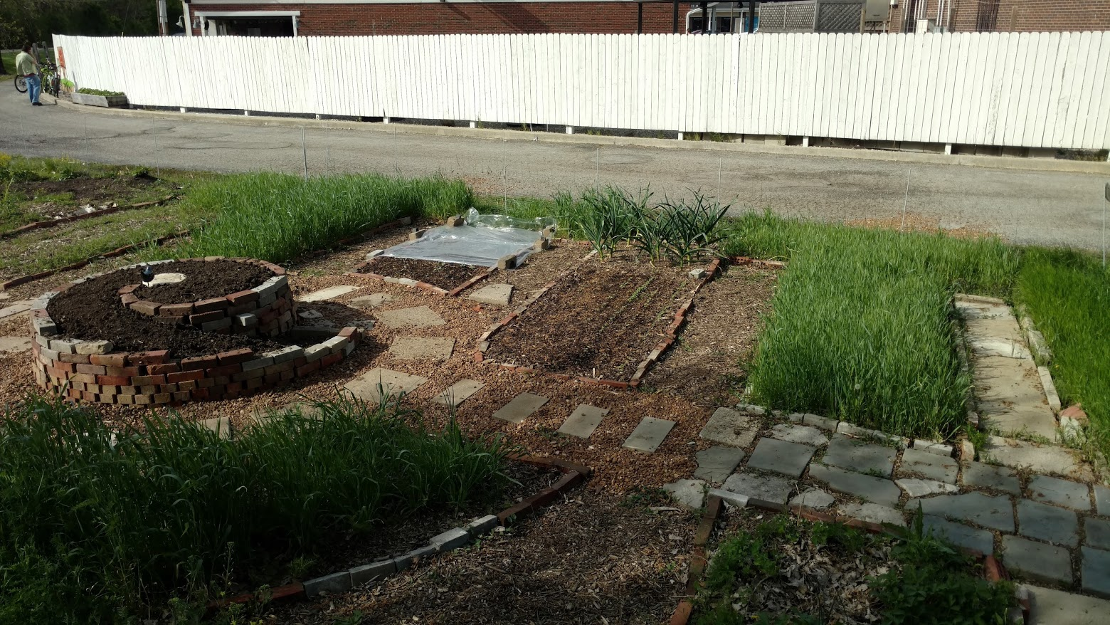
Cover Crops
Benefits
Builds network of roots in soil to increase porosity
Can be tailored to fit your garden schedule
Adds nutrients to the soil
Serves as a mulch for spring
Inexpensive
Attractive

Slide 33
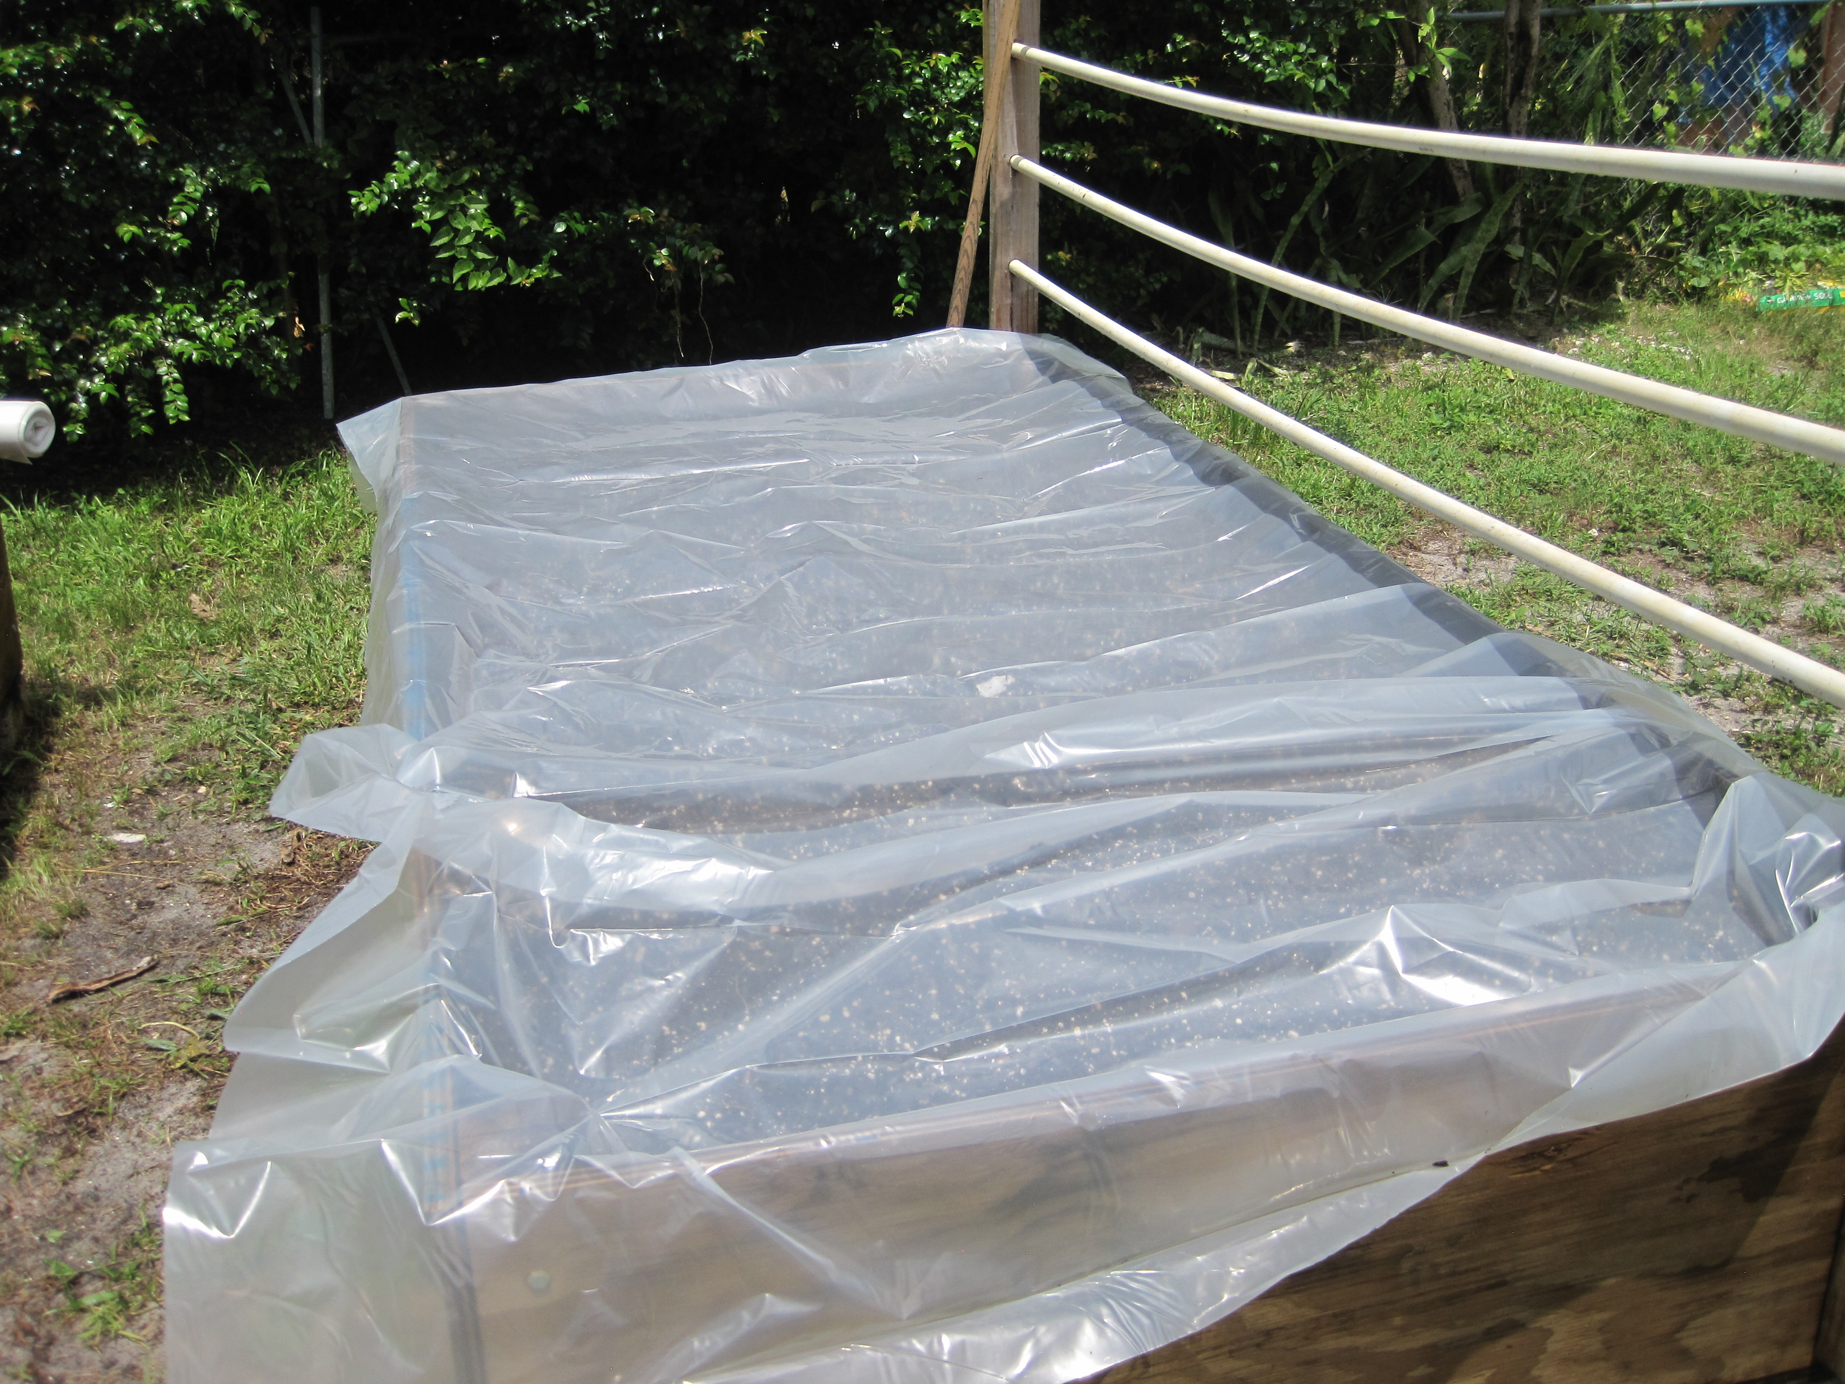
Solarization
Effective toward eliminating invasive and aggressive weeds that spread by rhizomes or have extensive root system
Increases temperature to above 140 degrees (or more)
Kills weed seeds near the surface
Also kills some bacteria and microbes (that’s not a good thing)
Inexpensive
Time consuming (6 weeks or more) and may require a seasonal fallow
May require rehabilitation strategy afterwards to inoculate bacteria

Slide 34
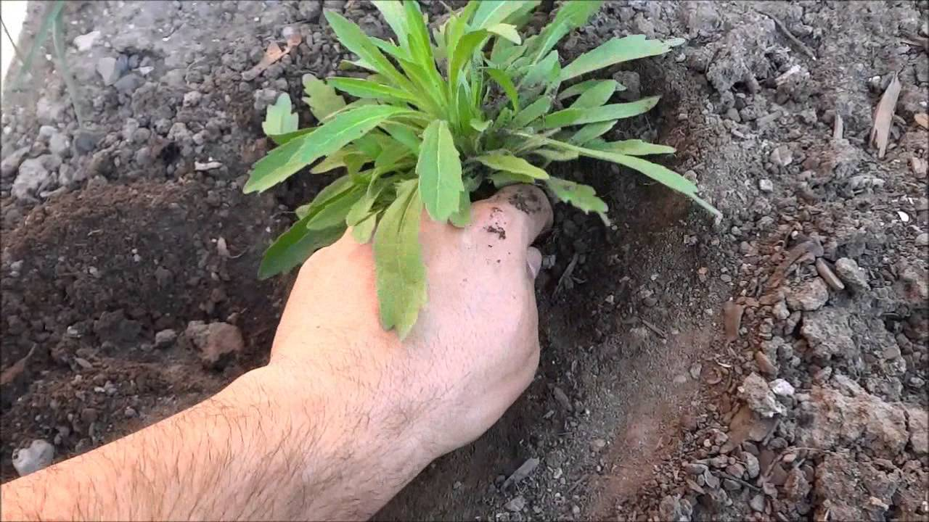
Mechanical Methods
Pulling
Hoeing
Tilling
Flaming

Slide 35
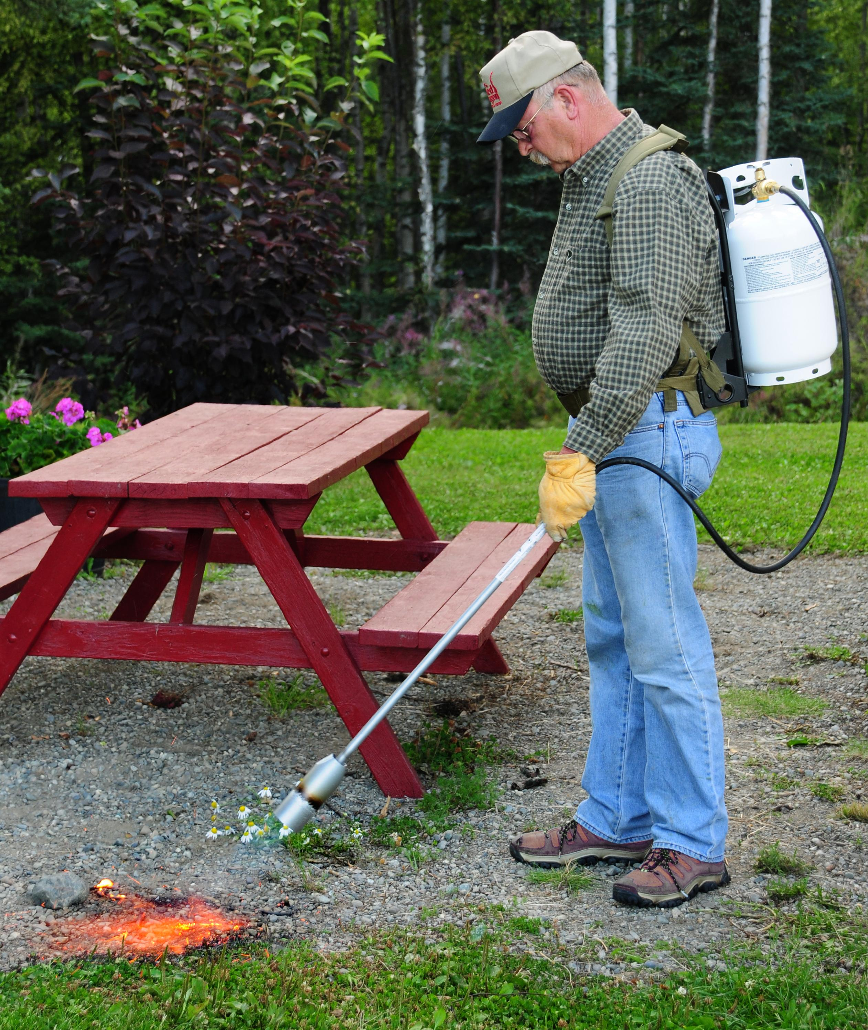
Flaming
Effective and simple for broad-leaved weeds
Ineffective with grasses
Can be used immediately before seeds sprout (if you direct sow)
Has been helpful toward eliminating thistle if used repeatedly
Video: https://goo.gl/photos/uiyeopDRq8nPDsC36

Slide 36
Chemical Methods
Allelopathy
Herbicides
Vinegar Herbicides

Slide 37
Stubborn Canada Thistle
Perennial
Spreads by seed and roots
Reaches flower by beginning of June
Seed production done in July
New shoots emerge during September and survive into November
Growth in late September and October helps restore underground food reserves
Seeds can survive burial in the ground for up to 20 years
Roots reach below tilling layer
Has adapted to RoundUp in field applications

Slide 38
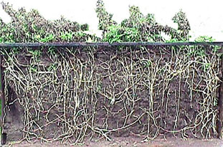
Stubborn Canada Thistle
Tilling and pulling promotes spread
Best time to treat with chemical solutions is just after flower begins but before full bloom in mid-June
Herbicides can be applied to stem after cutting
Shading is effective
Smothering with inorganic mulch or solarizing
Repeated flaming and vinegar applications may be affective but requires persistence
Rye, using allelopathy, has shown to be effective
Add organic matter to decrease soil compaction

